Slide 1


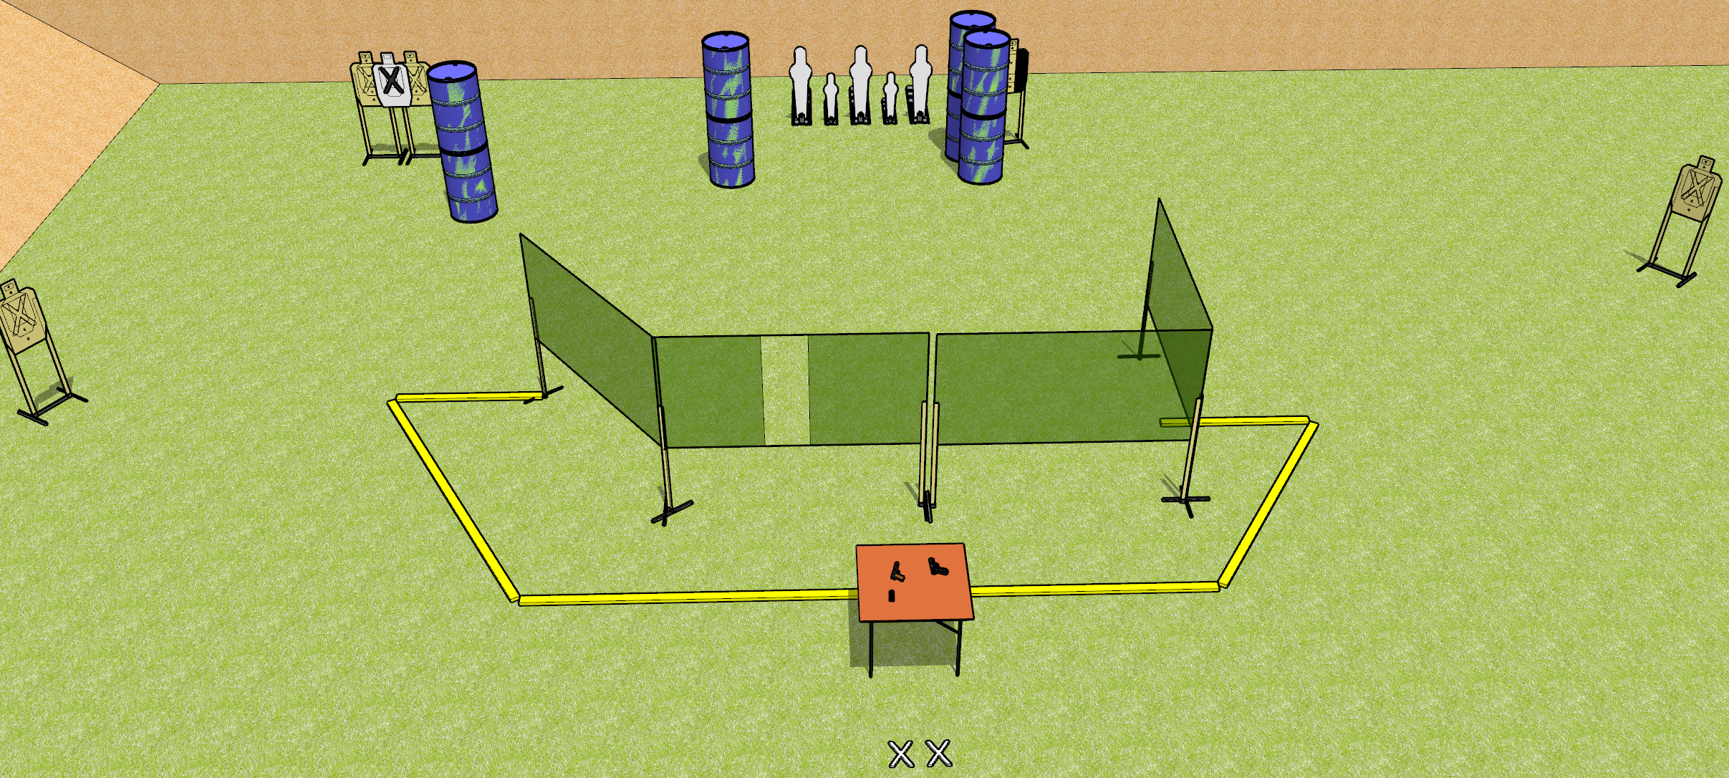
 | Dothan Gun Club – USPSA Match Triple Tap Course Designer : Drew Coleman
START POSITION : Standing with both feet on X’s, wrists below belt
GUN READY CONDITION : Pistol/PCC unloaded on table, trigger guard on mark. Magazines on belt. |  | SCORING: Comstock, 20 rounds TARGETS: 5 paper, 5 Steel SCORED HITS: Best 3 on paper, steel until down START-STOP: Audible, last shot RULES: Pistol/PCC must be slide/cylinder/bolt closed, hammer down.
STAGE PROCEDURE: Engage targets as they become available from within the fault lines.

